Slide 1


R. GLENN
HUBBARD
ANTHONY PATRICK
O’BRIEN
FIFTH EDITION
© 2015 Pearson Education, Inc.

Slide 2
Long-Run Economic Growth: Sources and Policies

Slide 3
Obtaining economic growth
In the previous chapter, we looked at ways to measure economic growth in the long and short terms.
In this chapter, we will consider the effects of different government policies on long-term economic growth.
Economic growth, after all, is not inevitable; history has seen long periods of stagnation where no sustained increases in output per capita occurred.
Why have some countries been able to achieve rapidly-increasing real GDP per capita, while other countries have failed to keep pace?
Our goal in this chapter is to develop a model of economic growth to help answer questions such as this.

Slide 4
Economic Growth over Time and around the World
22.1
Define economic growth, calculate economic growth rates, and describe global trends in economic growth.

Slide 5
From prehistory to the middle ages
Economist Brad DeLong estimates that in 1,000,000 B.C., our ancestors had a GDP per capita of approximately $145.
He estimates that GDP per capita in 1300 A.D. was also about $145.
In other words, no sustained economic growth occurred before the middle ages; a peasant on a farm in 1300 A.D. was about as well off his ancestors.

Slide 6
The industrial revolution
Significant economic growth did not really begin until the Industrial Revolution, the application of mechanical power to the production of goods and services which began in England around 1750.
Before this, production of most goods had relied on human or animal power.
The use of mechanical power allowed England and other countries—like the United States, France, and Germany—to begin to experience long-run economic growth.

Slide 7

Why did the Industrial Revolution begin in England?
Nobel Laureate Douglass North argues that the Glorious Revolution of 1688 was a key turning point in the economic history of Britain.
After that date, the British Parliament, rather than the king, controlled the government. The court system also became independent of the king.
The government was then able to make credible promises regarding upholding property rights, protecting wealth, and the elimination of arbitrary tax increases.
This, claims North, made entrepreneurs willing to make the investments necessary for the industrial revolution to take hold.

Slide 8
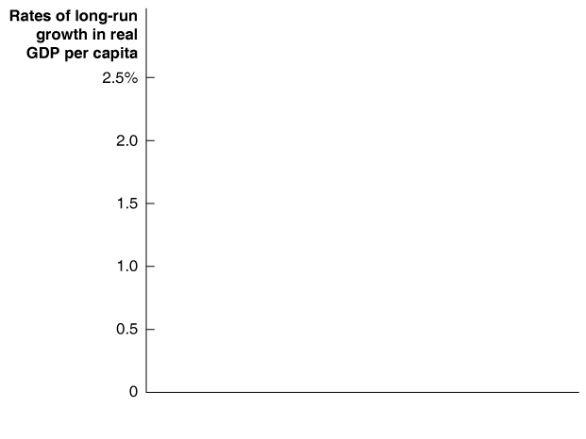
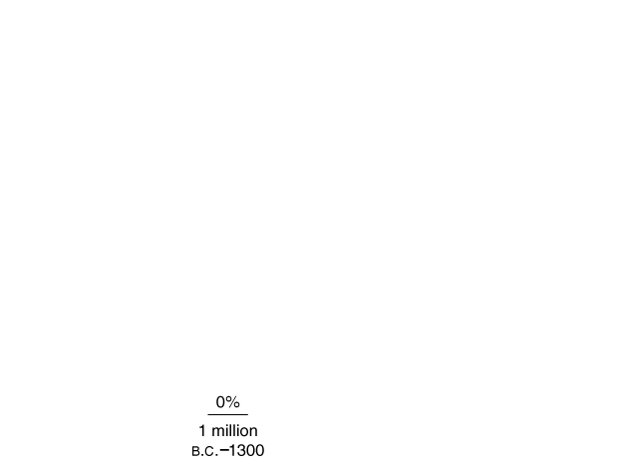

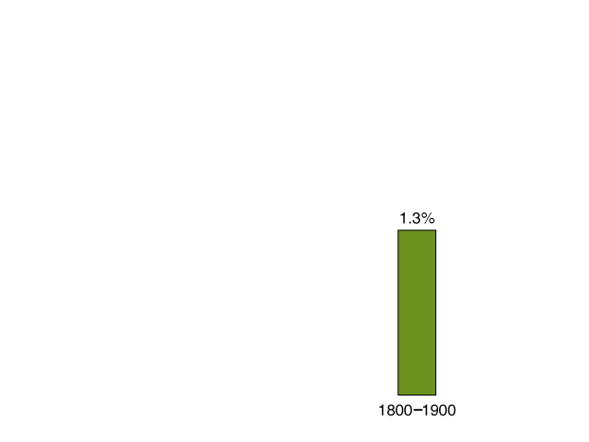

Average annual growth rates ar
The graph shows Brad DeLong’s estimated average annual growth rates for the world economy.
The Industrial Revolution, and its subsequent spread throughout the world, resulted in sustained increases in real GDP per capita.
Figure 11.1
Average annual growth rates for the world economy
Notes:
World economic growth was essentially zero in
the years before 1300, and it was very slow—an
average of only 0.2 percent per year—between
1300 and 1800. The Industrial Revolution
made possible the sustained increases in real
GDP per capita that have allowed some countries
to attain high standards of living.
Source: J. Bradford DeLong, “Estimating World
GDP, One Million b.c.–Present,” Working paper,
University of California, Berkeley.

Slide 9
Why do growth rates matter?
The difference
between 1.3% and
2.3% may not seem
like much; but over a
long period, it makes a
remarkable difference.
Over 50 years, a 1.3%
growth rate leads to
about a 91% increase
in real GDP per capita.
But a 2.3% growth rate leads to about a 212% increase.
In the long run, small differences in economic growth rates result in big differences in living standards.
Figure 11.1
Average annual growth rates for the world economy

Slide 10
Differences in incomes across countries
Economists often refer to the high-income countries (or industrial countries) of Western Europe, Australia, Canada, Japan, New Zealand, and the United States, in comparison to the poorer developing countries of the rest of the world.
The 1980s and 1990s have seen some countries progress out of the developing category, like Singapore, South Korea, and Taiwan; these are often referred to as newly industrializing countries.
Real GDP per capita is markedly different across the world, even after correcting for cost of living differences. In 2012 it ranged from a high of $103,900 in Qatar to a low of $400 in the Democratic Republic of the Congo.

Slide 11






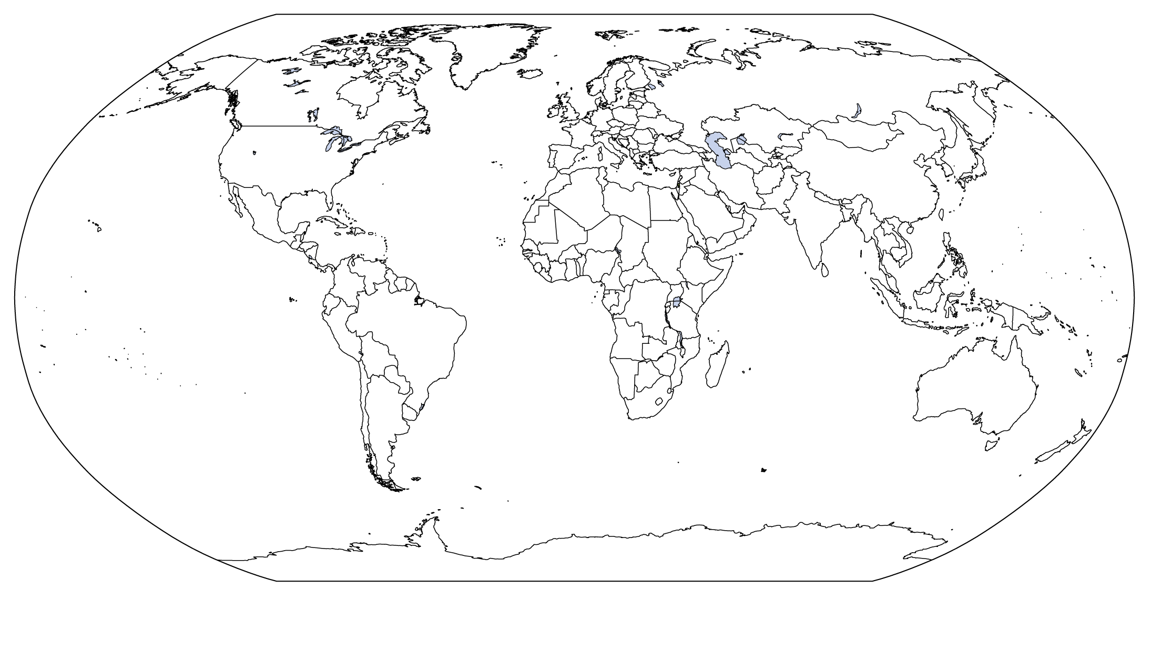





GDP per capita in 2012
The figure shows GDP per capita (in $US) in 2012 for each of the world’s nations, adjusted for differences in the cost of living.
Figure 11.2
GDP per capita, 2012
Notes:
GDP per capita is measured in U.S. dollars, corrected for differences across countries in the cost of living.

Slide 12

Is income all that matters?
By concentrating on income differences between countries, are economists missing something important?
While incomes have not been rising in, for example, sub-Saharan Africa, economist Charles Kenny with the World Bank argues that those countries have made rapid advances in health, education, and civil and political liberties.
William Easterly, an economist at NYU, confirms that advances in these factors do not necessarily go hand in hand with income increases, but are essential to raising living standards.

Slide 13
What Determines How Fast Economies Grow?
22.2
Use the economic growth model to explain why growth rates differ across countries.

Slide 14
Developing a model of economic growth
An economic growth model seeks to explain growth rates in real GDP per capita over the long run.
As we noted last chapter, the key to this is labor productivity: the quantity of goods and services that can be produced by one worker or by one hour of work.
Two main factors affect labor productivity:
The quantity of capital per hour worked, and
The level of technology.
So our model will concentrate on changes in the quantity of capital, and technological change.
Technological change: A change in the quantity of output a firm can produce using a given quantity of inputs.

Slide 15
Technological change
There are three main sources of technological change:
Better machinery and equipment
Inventions like the steam engine, machine tools, electric generators, and computers, have allowed faster economic growth.
Increases in human capital
Human capital is the accumulated knowledge and skills that workers acquire from education and training or from their life experiences.
Better means of organizing and managing production
If managers can do a better job of organizing production, then labor productivity can increase. An example of this is the just-in-time system, first developed by Toyota; this involves assembling goods from parts that arrive at the factory exactly when they are needed.

Slide 16



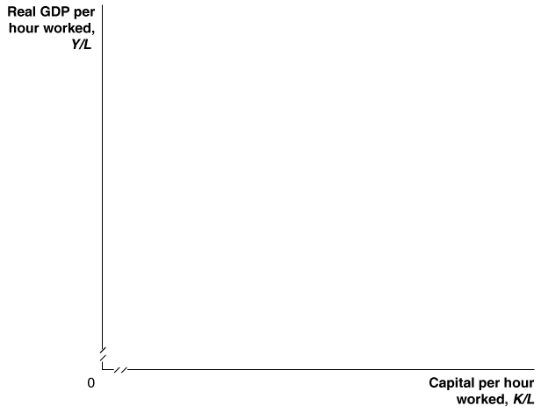
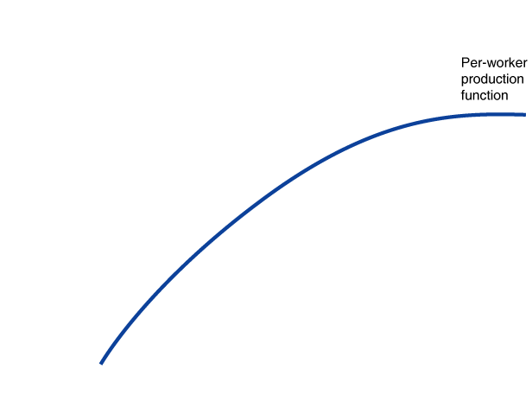
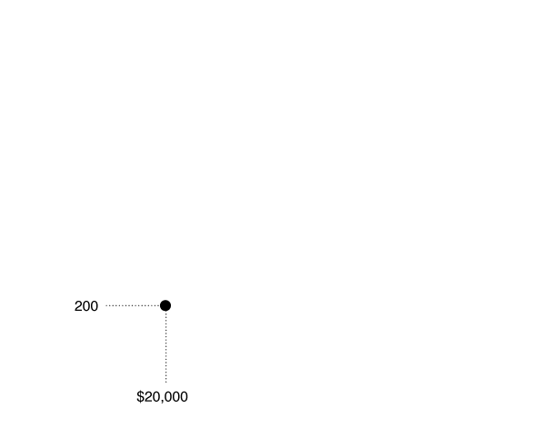
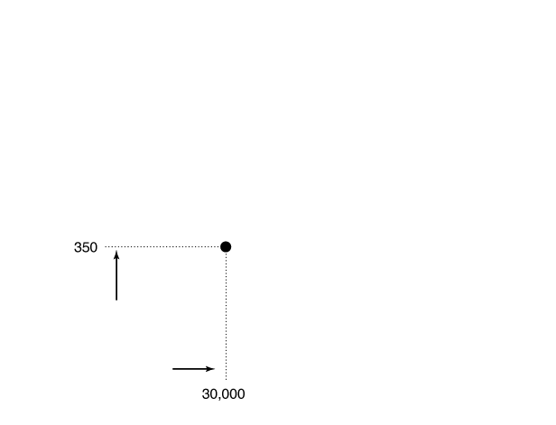
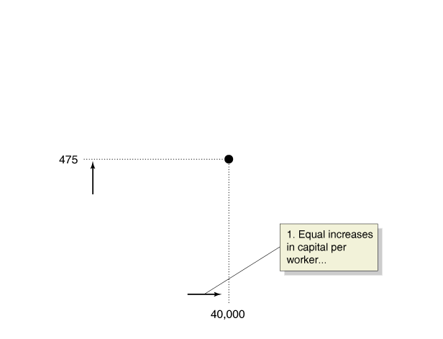
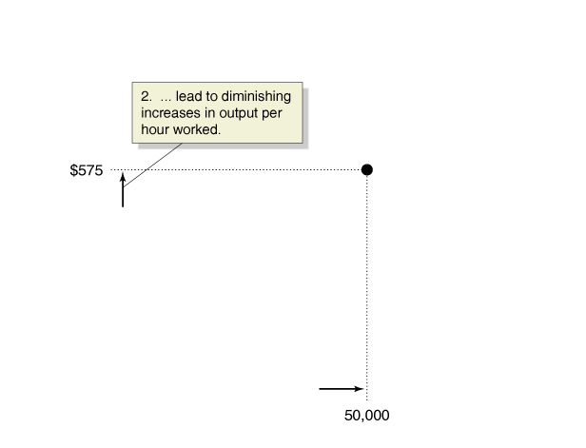
Production per worker
Suppose we wanted to describe a per-worker production function: the relationship between real GDP per hour worked, and capital per hour worked, holding the level of technology constant.
The first units of capital would be the most effective, allowing output per hour to increase most.
Figure 11.3
The per-worker production function
Subsequent increases would result in diminishing returns: smaller increases in output resulting from increasing one factor of production progressively higher while keeping the other factors of production constant.
Notes:
The per-worker production function shows
the relationship between capital per hour
worked and real GDP per hour worked,
holding technology constant. Increases in
capital per hour worked increase output
per hour worked but at a diminishing rate.
For example, an increase in capital per hour
worked from $75 to $100 increases real GDP
per hour worked from $48 to $53. An increase
in capital per hour worked from $100
to $125 increases real GDP per hour worked
by a smaller amount from $53 to $57. Each
additional $25 increase in capital per hour
worked results in a progressively smaller increase
in output per hour worked.

Slide 17
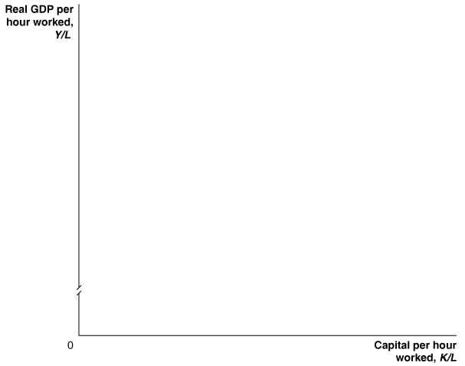
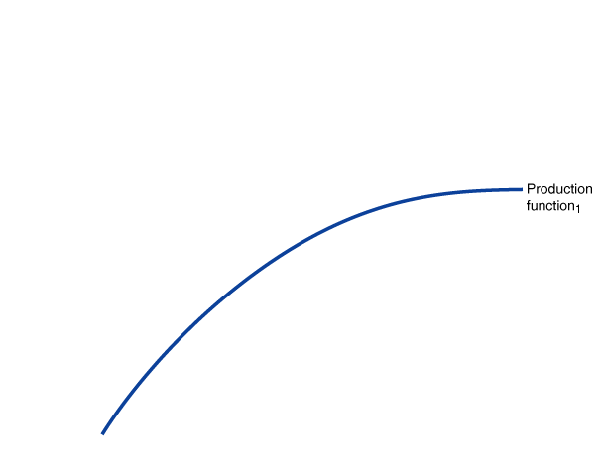
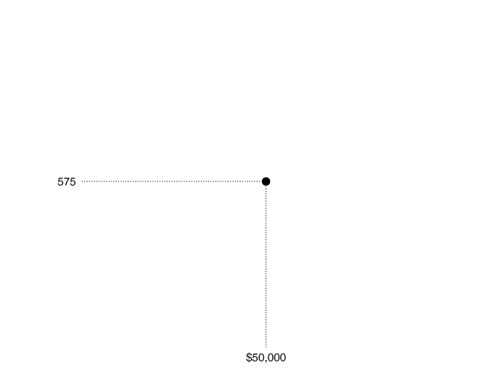
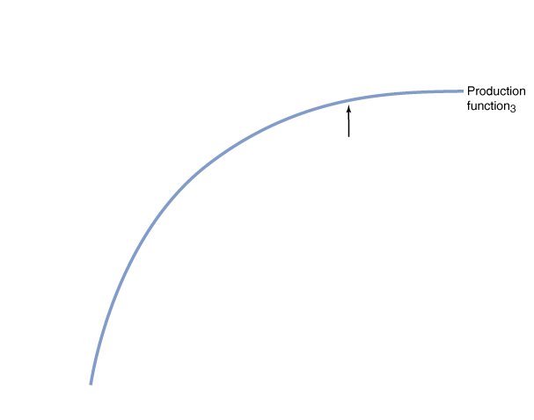
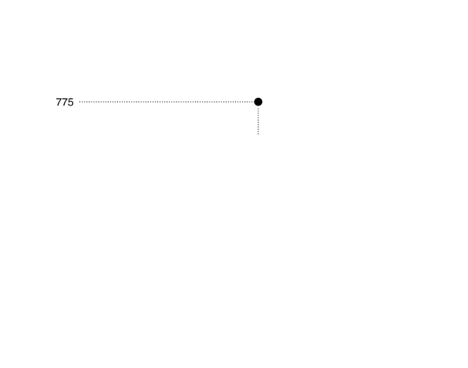
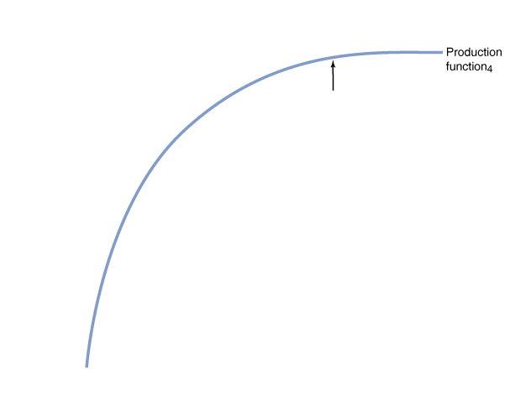
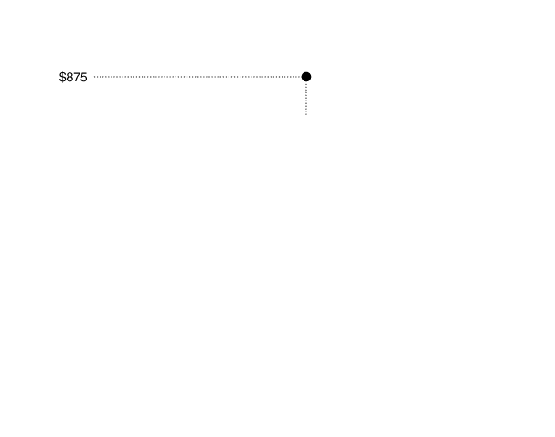
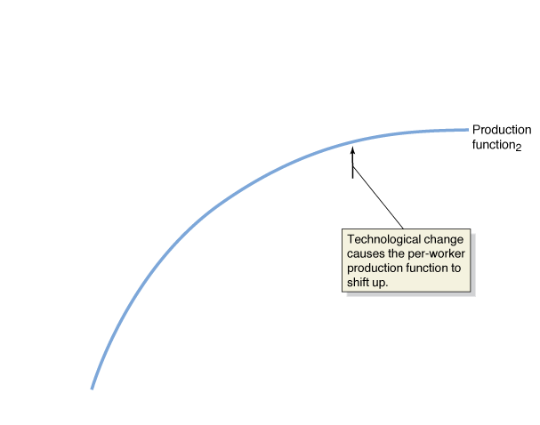

More capital or technological change?
If a country is relatively lacking in capital—like many of the developing countries—increase in capital will be very effective at increasing real GDP per capita.
In countries where the amount of capital is already relatively high, technological change becomes a more effective way to increase output per hour.
Figure 11.4
Technological change increases output per hour worked
Notes:
Technological change shifts up the production
function and allows more output
per hour worked with the same amount of
capital per hour worked. For example, along
Production function1 with $150 in capital
per hour worked, the economy can produce
$60 in real GDP per hour worked. However,
an increase in technology that shifts the
economy to Production function2 makes
it possible to produce $65 in real GDP per
hour worked with the same level of capital
per hour worked.

Slide 18

The economic failure of the Soviet Union
Under Communism, the Soviet Union was a centrally planned economy, where the government owned nearly every business and made all production and pricing decisions.
The Soviets concentrated on improving their capital stock; and in the 1950s, their output per hour improved faster than in the United States.
But Soviet managers had little incentive to develop new ways of doing things; and they did not have to worry about competition. This retarded technological change and resulted in slowing growth rates for output in the Soviet Union.

Slide 19
New growth theory
The model of economic growth we have developed was essentially developed by Nobel Laureate Robert Solow in the 1950s.
Solow did not seek to explain technological change, instead treating it as the result of chance scientific discoveries.
Paul Romer developed the new growth theory, a model of long-run economic growth that emphasizes that technological change is influenced by economic incentives and so is determined by the working of the market system.

Slide 20
New growth theory and knowledge capital
Romer argues that the accumulation of knowledge capital is a key determinant of economic growth. Increases in knowledge capital result from research and development, and other technological advances.
Physical capital is rival and excludable—a private good—and this results in its diminishing returns.
But knowledge capital is nonrival and nonexcludable—a public good—and hence results in increasing returns—not at the firm level, but at the economy level.

Slide 21
Government’s role in knowledge capital generation
Public goods such as knowledge capital generation result in free-riding: benefitting from goods and services you do not pay for.
Example: Bell Labs’ development of transistor technology resulted in immense profits for other firms.
Because firms do not enjoy the entire benefit of their knowledge capital, they do not produce enough of it.
The public good nature of knowledge capital leads to a role for government policy in:
Protecting intellectual property with patents and copyrights
Subsidizing research and development
Subsidizing education

Slide 22
Protecting intellectual property
Governments seek to protect intellectual property through the use of patents and copyrights.
Allowing firms to benefit from their own research and development increases their incentive to perform it.
Patents are the exclusive right to produce a product for a period of 20 years from the date the patent is applied for. This period of time is designed to balance the chance for firm to benefit from its invention against the need of society to benefit from it.
Copyrights act similarly for creative works like books and films, granting the exclusive right to use the creation during and 70 years after the creator’s lifetime.

Slide 23
Subsidizing R&D and education
Subsidizing research and development
Governments might perform research directly—like NASA and the National Institutes of Health—or subsidize researchers at institutions like universities.
Similarly, they can provide tax-incentives to firms performing R&D.
Subsidizing education
In order to perform research and development, workers need to be technically trained. If firms provide this training, they recoup the cost by paying workers lower wages, decreasing the incentive for workers to take such jobs.
A solution to this is to have the government subsidize education, as it does in all high-income countries.

Slide 24
Joseph Schumpeter and creative destruction
Joseph Schumpeter was born in Austria in 1883, and grew up there before moving to the United States. Schumpeter developed a model of growth emphasizing his view that new products unleashed a “gale of creative destruction”.
Example: The automobile replaced the horse-drawn carriage by serving better the needs of consumers. This “creation” “destroyed” carriage-makes and associated firms.
To Schumpeter, the entrepreneur is central to economic growth; and the profits of entrepreneurs provide the incentive for bringing together the factors of production—labor, capital, and natural resources—in new ways.

Slide 25
Economic Growth in the United States
22.3
Discuss fluctuations in productivity growth in the United States.

Slide 26


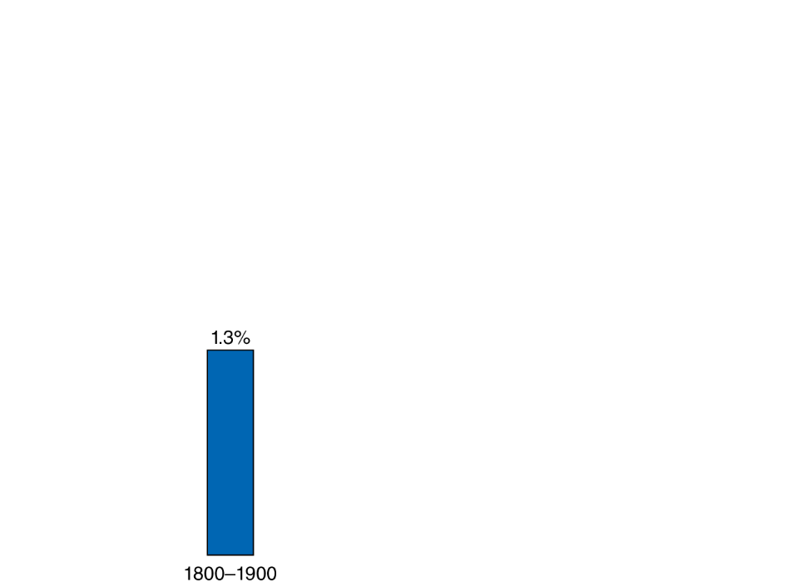
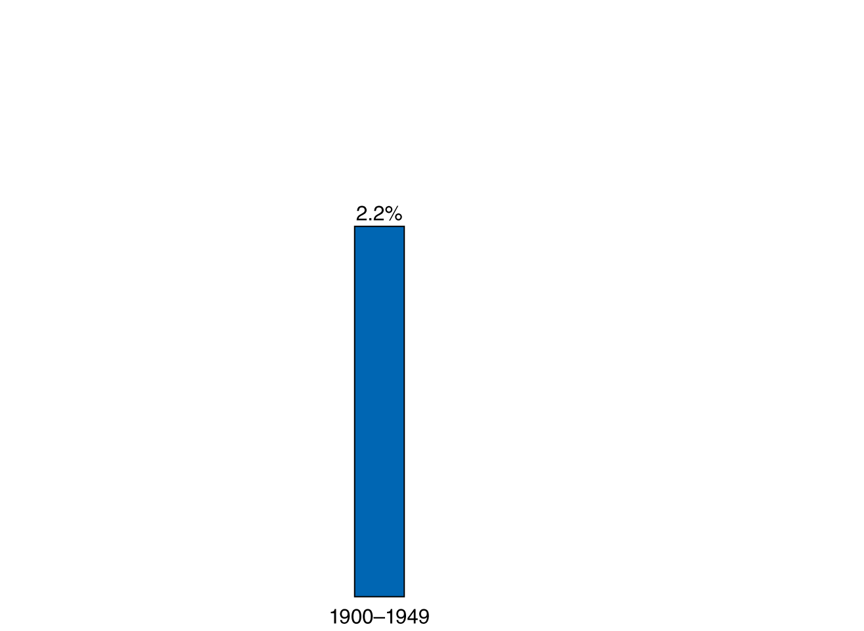
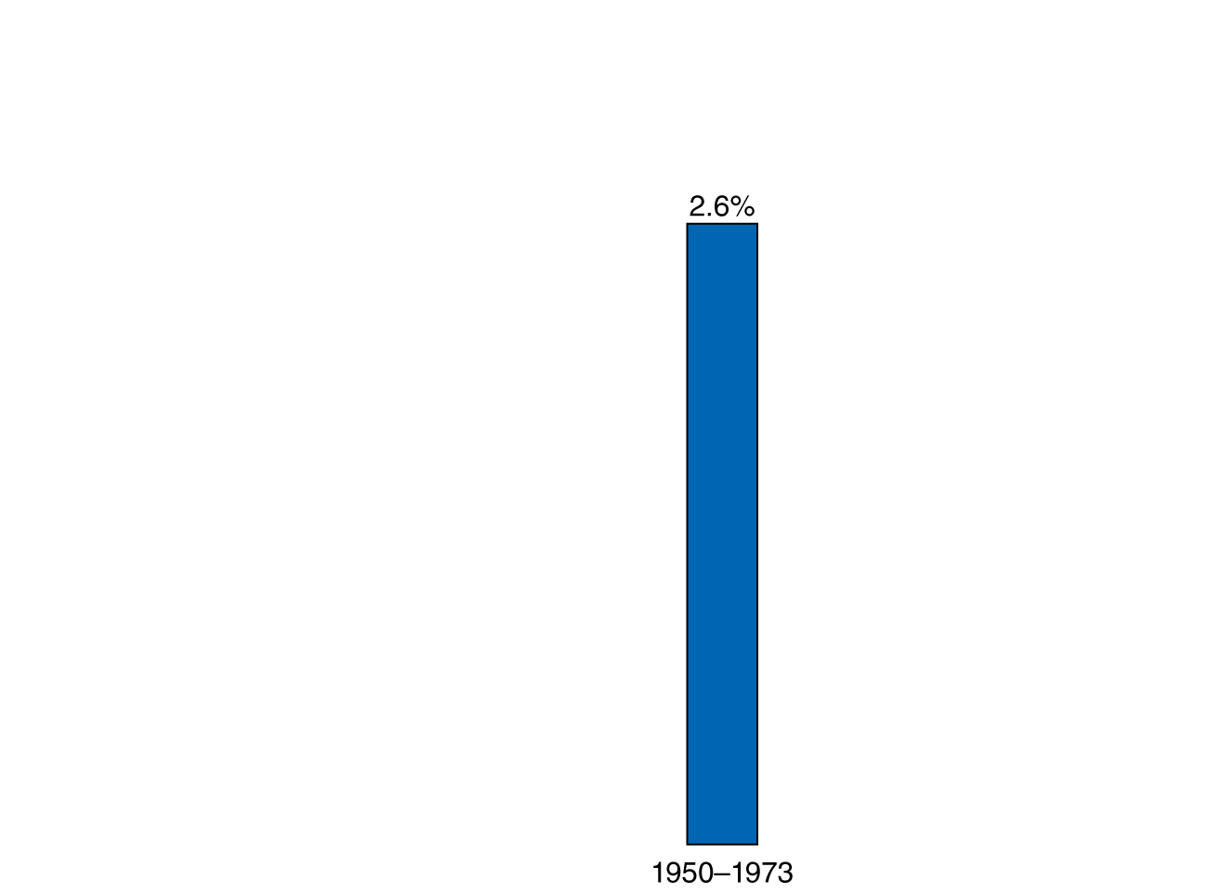
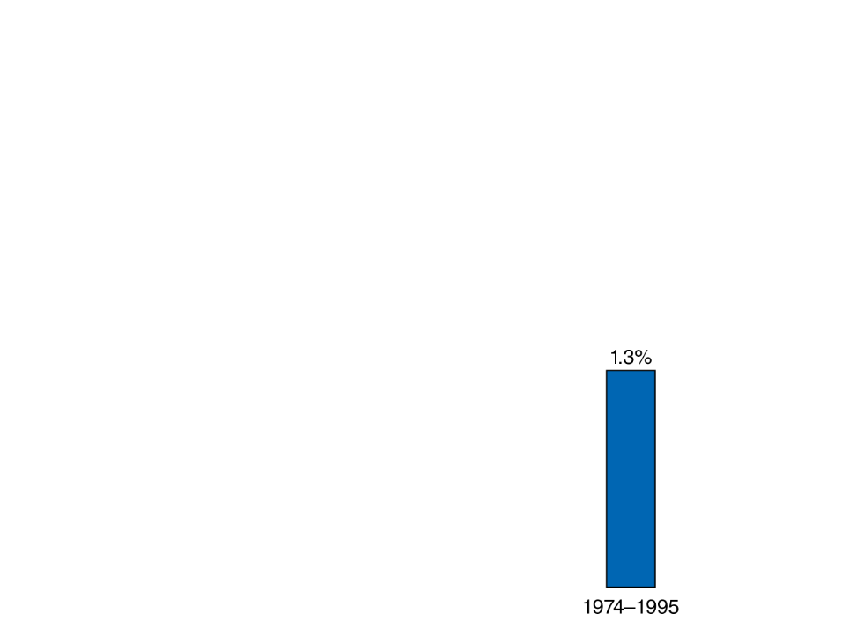

Economic growth in the United States
Growth rates in the United States were relatively modest
prior to 1900.
In the 20th century, firms and the U.S. government invested heavily in research and development, resulting in increasing growth rates.
Growth rates remained high until the mid-1970s, when they fell unexpectedly, before picking up again in the mid-1990s.
Figure 11.5
Average annual growth rates in real GDP per hour worked in the United States
Notes:
The growth rate in the United States increased
from 1800 through the mid-1970s.
Then, for more than 20 years, growth slowed
before increasing again in the mid-1990s.
Note: The values for 1800–1900 are real GDP
per worker. The values for 1900–2012 are real
GDP per hour worked; for the period 1900–1969
they are the authors’ calculations, based on the
methods used in Neville Francis and Valerie
A. Ramey, “The Source of Historical Economic
Fluctuations: An Analysis Using Long-Run
Restrictions,” in Jeffrey Frankel, Richard Clarida,
and Francesco Giavazzi, eds., International
Seminar in Macroeconomics, Chicago:
University of Chicago Press, 2005; the authors
thank Neville Francis for kindly providing data
through 2004; for 1969–2012, the data are from
the U.S. Bureau of Labor Statistics.

Slide 27
What caused the productivity slowdown of 1974-95?
Some economists argue that there was not really a slowdown in economic growth—the appearance is a result of how we measure growth.
From the 1970s, most growth in output came in the form of services rather than goods. Improvements in services come mostly through quality differences, which are harder to measure for services than for goods.
An alternative argument is that America concentrated more on quality-of-life issues, like health and safety, environmental regulations, and a change in educational focus.
Other high-income countries experienced similarly-timed slowdowns, suggesting that the United States was not doing something uniquely counter-productive over this time.

Slide 28
Is the U.S. headed for another productivity slowdown?
New technology has driven improvements in labor productivity from 1996-2012.
Examples: faster data processing (computers etc.); better communication (cell phones, the internet)
Some economists argue that changes in quality of services have been particularly important over the last decade and a half.
So GDP growth has understated the actual growth of the economy.
But it may be that many of these gains are going to improving consumer products rather than improving labor productivity.
This casts doubt on the future of economic growth in the U.S.

Slide 29
Why Isn’t the Whole World Rich?
22.4
Explain economic catch-up and discuss why many poor countries have not experienced rapid economic growth.

Slide 30
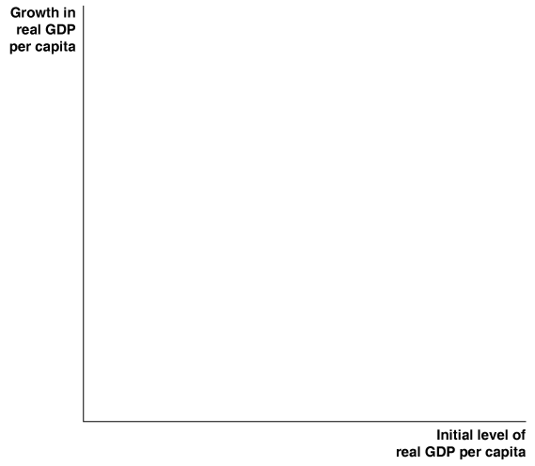
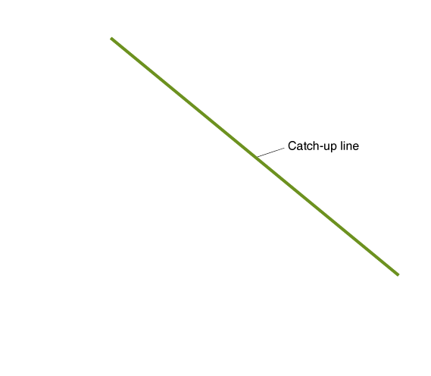
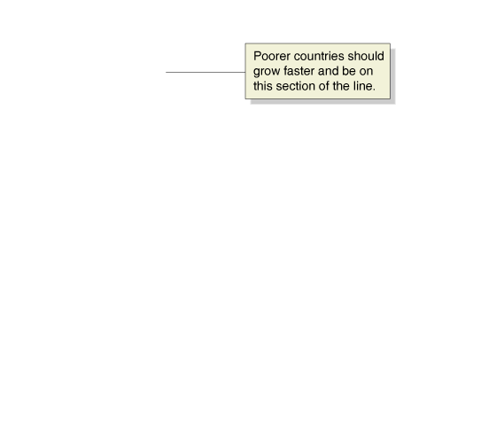
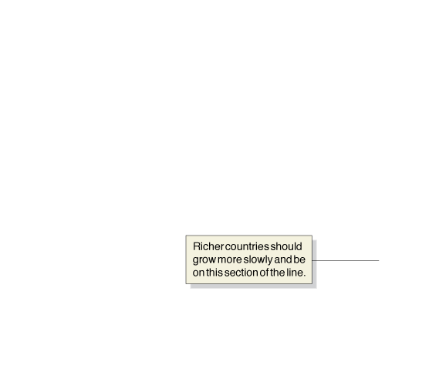
How can we predict nations’ growth rates?
The economic growth model predicts that poor countries will grow faster than rich countries.
This is because:
The effect of additional capital is greater, for countries with smaller capital stocks
There are greater advances in technology immediately available to poorer countries
This leads to a prediction of catch-up: that the level of GDP per capita (or income per capita) in poor countries will grow faster than in rich countries.
Figure 11.6
The catch-up predicted by the economic growth model
Notes:
According to the economic growth model,
countries that start with lower levels of real
GDP per capita should grow faster (points
near the upper-left section of the line) than
countries that start with higher levels of real
GDP per capita (points near the lower-right
section of the line).

Slide 31

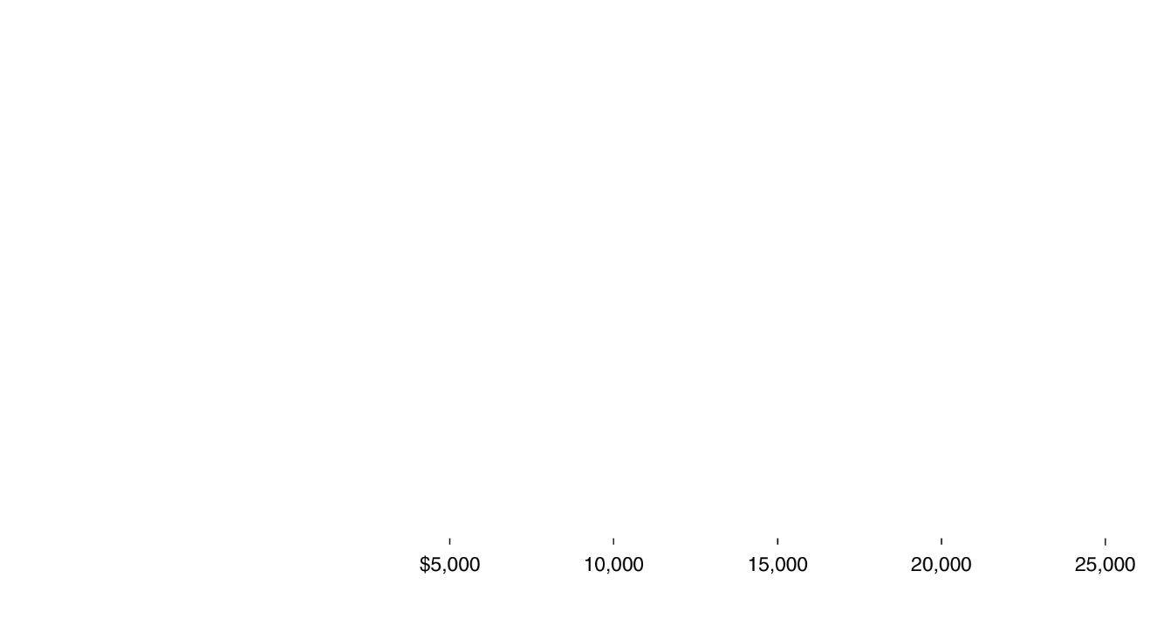












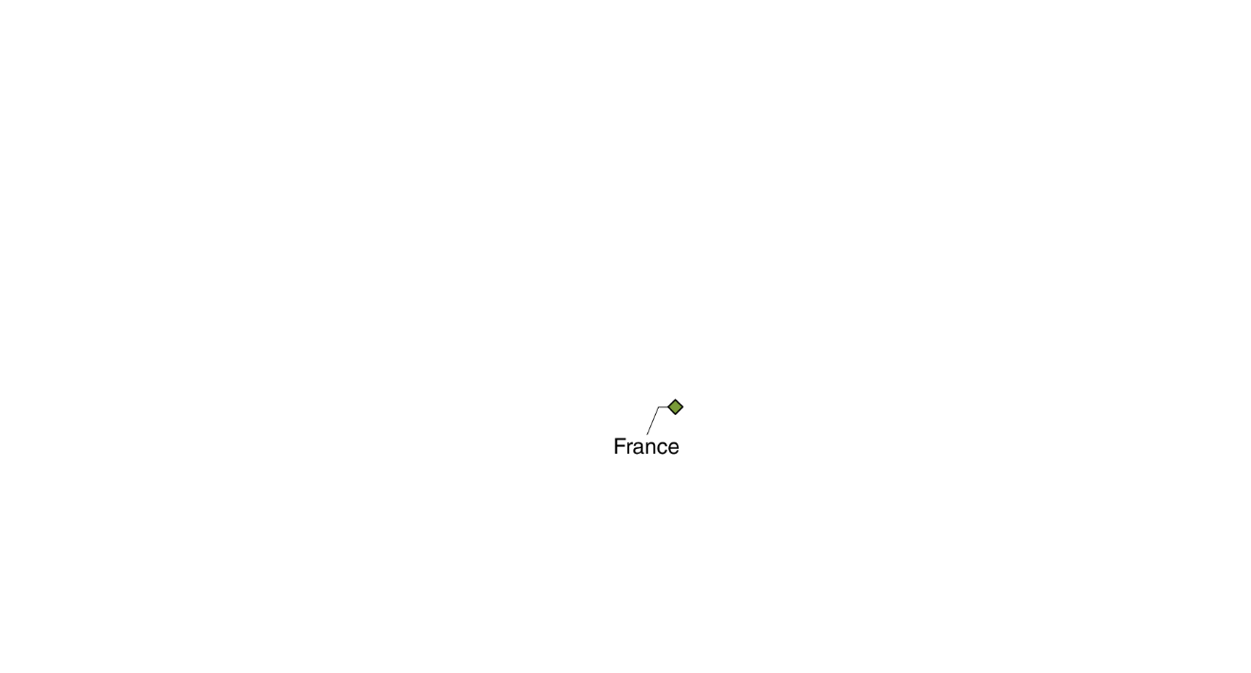





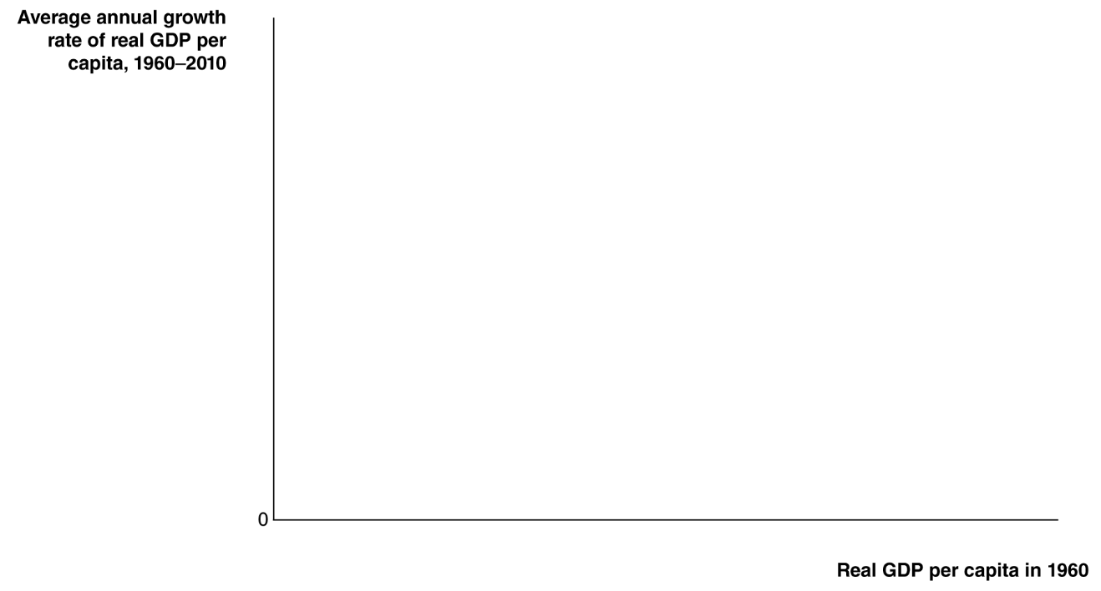
Catch-up among high income countries
Examining high-income countries, we see strong evidence
of the catch-up hypothesis.
Countries that were richer in 1960, like the U.S. and Switzerland, experienced lower growth rates over the next decades than countries that were initially poorer, like Ireland, Singapore, and South Korea.
Figure 11.7
There has been catch-up among high-income countries
Notes:
we look only at countries that currently have high incomes, we see that
countries such as Taiwan, Korea, and Singapore that had the lowest incomes
in 1960 grew the fastest between 1960 and 2010. Countries such as Switzerland
and the United States that had the highest incomes in 1960 grew the
slowest.
Note: Data are real GDP per capita in 2005 dollars. Each point in the figure represents
one high-income country.
Authors’ calculations from data in Alan Heston, Robert Summers, and Bettina Aten,
Penn World Table Version 7.1, Center for International Comparisons of Production,
Income and Prices at the University of Pennsylvania, November 2012.

Slide 32

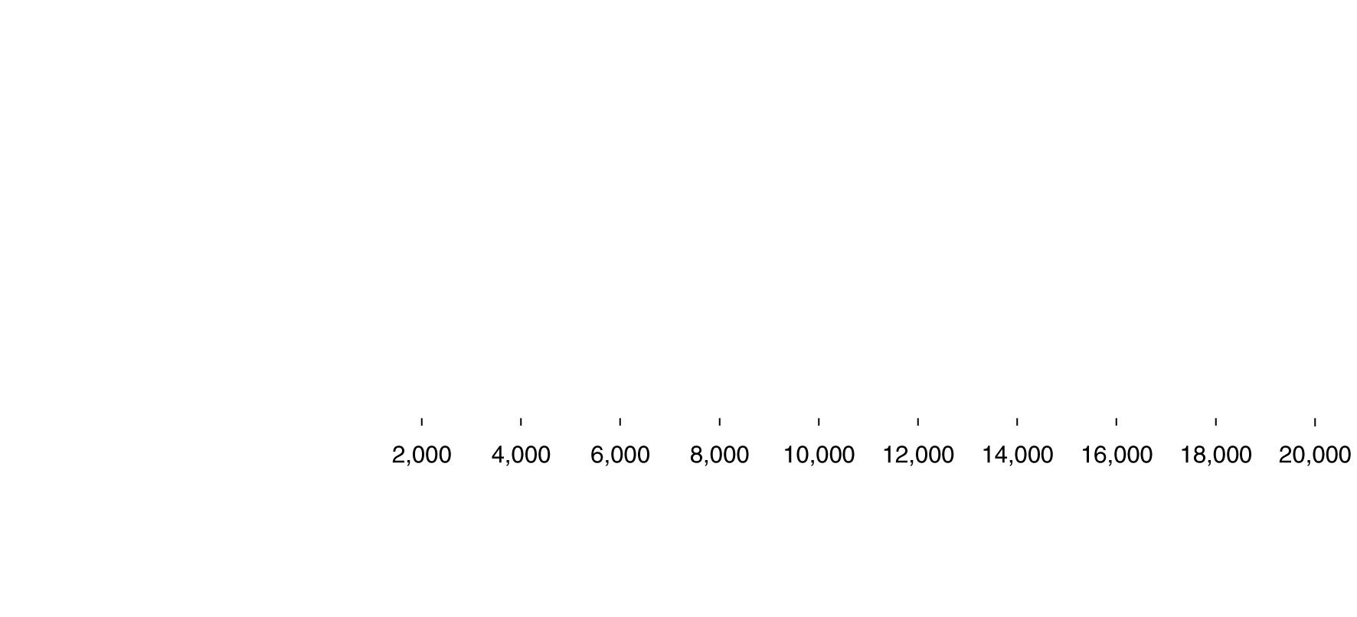
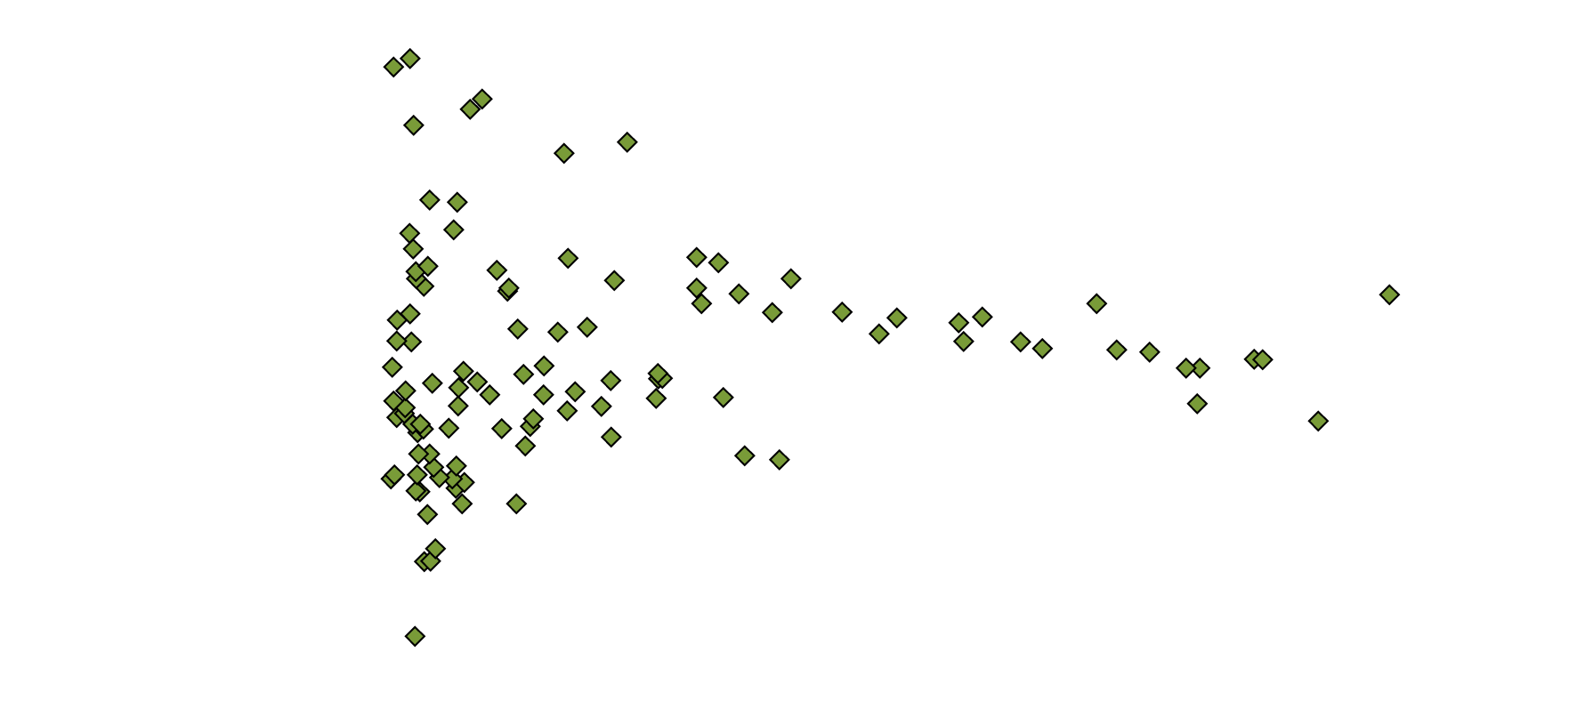
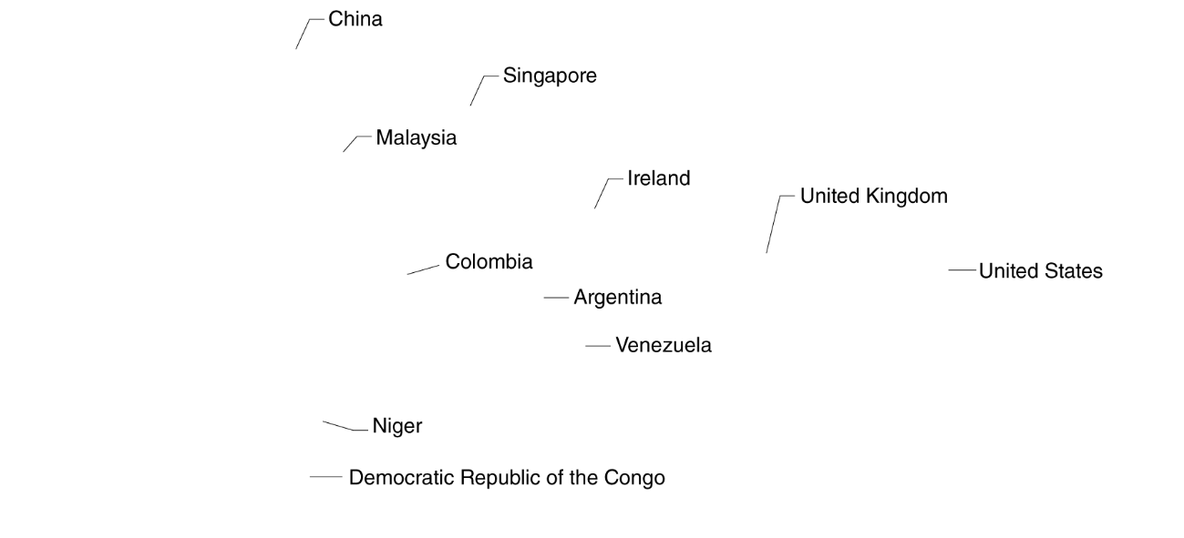
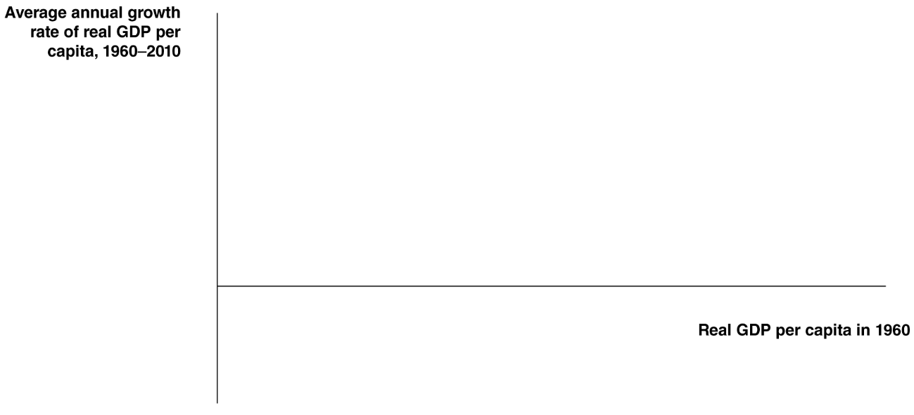
Catch-up among all countries?
However if we extend the set of countries to all countries for which statistics are available, our catch-up model appears to be worthless.
We need to address the failures of the catch-up model.
Figure 11.8
Most of the world hasn’t been catching up
Notes:
If we look at all countries for which statistics are available, we do not see the catchup
predicted by the economic growth model. Some countries that had low levels
of real GDP per capita in 1960, such as Niger and the Democratic Republic of
the Congo, actually experienced negative economic growth. Other countries that
started with low levels of real GDP per capita, such as Malaysia and China, grew
rapidly. Some middle-income countries in 1960, such as Venezuela, hardly grew
between 1960 and 2010, while others, such as Ireland, experienced significant
growth.
Note: Data are real GDP per capita. Each point in the figure represents one country.
Authors’ calculations from data in Alan Heston, Robert Summers, and Bettina Aten,
Penn World Table Version 7.1, Center for International Comparisons of Production,
Income and Prices at the University of Pennsylvania, November 2012.

Slide 33
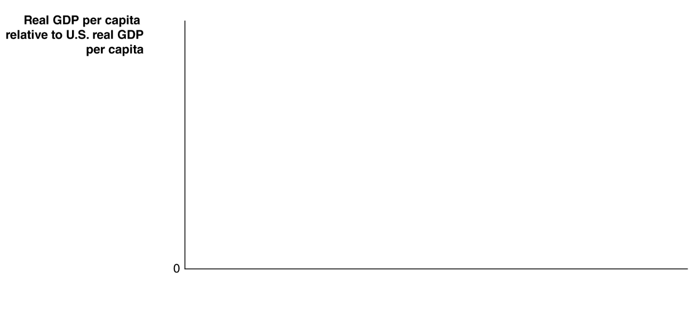

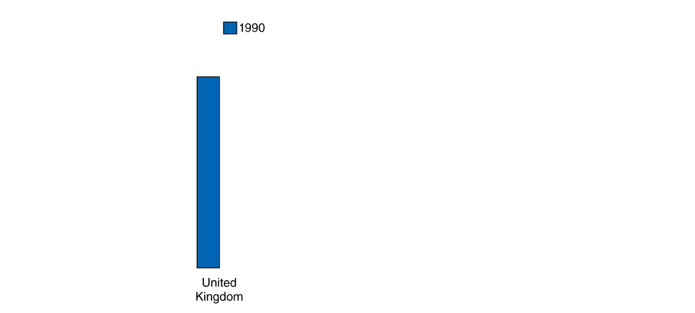













Other high-income countries vs. the U.S.
The blue bars show real GDP per capita
in 1990 relative to the United States.
The red bars show real GDP per capita
in 2012 relative to the United States.
In each case, the red bar is lower; these countries are not catching up to the United States. Why?
Figure 11.9
Other high-income countries have stopped catching up to the United States
Notes:
The blue bars show real GDP per capita in 1990 relative to the United States, and
the red bars show real GDP per capita in 2012 relative to the United States. In each
case, relative levels of real GDP per capita are lower in 2012 than they were in 1990,
which means that these countries have ceased catching up to the United States.
Sources: Authors’ calculations from data in Alan Heston, Robert Summers, and Bettina
Aten, Penn World Table Version 7.1, Center for International Comparisons of Production,
Income and Prices at the University of Pennsylvania, November 2012; and Organization
for Economic Cooperation and Development, OECD stat.extracts.

Slide 34
Why are high-income countries not catching the U.S.?
A combination of reasons explain this:
U.S. labor markets are relatively flexible; hiring and firing workers is relatively unrestricted by government regulation.
  Similarly, American workers tend to enter the work force sooner and retire later than do workers in Europe.
The U.S. financial system is relatively efficient, and the high volume of trading ensures high liquidity, making the U.S. an attractive place to invest.
  Small firms find obtaining capital relatively easy in the U.S. due to the advent of venture capital firms.

Slide 35
The lack of growth in many low-income countries
Economists point to four key factors in explaining why many low-income countries are growing so slowly:
Failure to enforce the rule of law
Wars and revolutions
Poor public education and health
Low rates of saving and investment
We will address each of these over the following slides.

Slide 36
Failure to enforce the rule of law
The rule of law refers to the ability of a government to enforce the laws of the country, particularly with respect to protecting private property and enforcing contracts.
For entrepreneurs in a market economy to succeed, the government must guarantee property rights: the rights individuals or firms have to the exclusive use of their property, including the right to buy or sell it.
Otherwise, entrepreneurs will not risk starting a business.
Also important is an independent court system to enforce contracts.

Slide 37
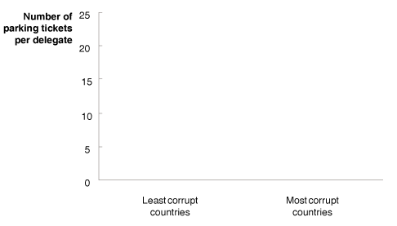


NYC parking tickets and international corruption
Every country sends delegates to the United Nations in New York City.
Under international law, these delegates are immune from prosecution under U.S. law.
This provides a test of a “culture of corruption”: when you are immune from the law, what do you do?
Two economists examined the numbers of parking tickets per delegate from the least and most corrupt countries. They found the most corrupt countries had delegates that ignored U.S. parking laws the most, suggesting a culture of ignoring the rule of law.

Slide 38
Other reasons for lack of growth in poor countries
Wars and revolutions
Wars and revolutions make investment and technological growth difficult.
Example: Mozambique had almost two decades of civil war in the 1970s and 1980s, with declining real GDP per capita.
When the civil wars ended, it experienced growth: 3.7% per year, from 1990 to 2009.
Poor public education and health
With weak public schools and poor health care, workers are less productive.
Low rates of saving and investment
Undeveloped and insecure financial systems create a “vicious cycle” of low savings and investment, preventing growth.

Slide 39
The benefits of foreign investment
One way to exit the vicious cycle of low savings and investment is through foreign investment:
Foreign direct investment: The purchase or building by a corporation of a facility in a foreign country.
Foreign portfolio investment: The purchase by an individual or a firm of stocks or bonds issued in another country.
In the Great Depression and WWII, many low-income countries were hurt by falling exports; but they took the wrong lesson, cutting themselves off from foreign trade and investment.
By the 1980s, many countries started to realize their mistake, and started to reverse these policies. This resulted in globalization, the process of countries becoming more open to foreign trade and investment. Countries embracing globalization experienced much higher rates of growth than countries that didn’t.

Slide 40
Growth Policies
22.5
Discuss government policies that foster economic growth.

Slide 41
Pro-growth policies
What sort of actions can governments take to encourage growth?
Enhancing property rights and the rule of law
Working toward independent courts and eliminating corruption is important for encouraging growth.
Although the U.S. is relatively free from corruption today, in the 1800s this was not the case. Reform efforts were important in setting the stage for growth.
Improving health and education
Health care and education have increasing returns for a country, with their benefits spilling over to other members of the country.
Improvements in these can help prevent brain drain, where highly educated and successful people leave developing countries to go to high-income countries.

Slide 42
More pro-growth policies
What sort of actions can governments take to encourage growth?
Policies that promote technological change
Technological change is essential for growth—as we have seen, often more important than acquiring capital.
Low-income countries can encourage technological change by encouraging foreign direct investment.
Policies that promote savings and investment
Eliminating corruption is important here, so that people know their assets won’t be seized.
Once this is done, governments can encourage savings and investment through tax incentives, like tax-deferred savings plans, or investment tax credits.

Slide 43

Will China’s standard of living exceed the U.S.?
If Chinese and American growth rates continue, China’s standard of living would exceed that of the U.S. in 2038.
Will this really happen? Several factors suggest that it will not:
Much of Chinese growth is due to capital investment, which will have diminishing returns.
Some of Chinese growth is due to transition to market economy.
Aging Chinese population due to population control policies.
China remains largely autocratic, with lingering concerns about security of property rights and independent rule of law.

Slide 44
Is economic growth good or bad?
A central assumption of this chapter is that economic growth is beneficial for citizens.
This seems relatively clear for low-income countries; but some people maintain that further economic growth may not be desirable in high-income countries.
Arguments against growth might include:
Negative effects on the environment
Depletion of natural resources
Diminishment of distinctive cultures
Since many of these arguments are normative, economic analysis can contribute to the debate, but cannot settle the issue.

Slide 45
Common misconceptions to avoid
High growth rates tend to increase standards of living; but a country can have high growth rates and still be very poor.
Long-term, sustained economic growth seems to be the key to improvements in standard of living; not short-term growth.
There is no single explanation for growth rates; nor is there a single economic variable that can explain growth.

